Slide 1
Interest and Dividend Income
New Jersey Slides
Tax Year 2018

Slide 2
Tax Exempt Interest
NJ does not always follow Federal taxability rules for interest
See NJ GIT-5 for list of taxable and tax-exempt obligations
Available from NJ Division of Taxation website

Slide 3
NJ Tax Rules for Taxability (GIT-5)
NJ Exempt
Most federal obligations
DC, Puerto Rico, Virgin Islands, US Possessions
NJ issued individual bonds
NJ obligations if in a mutual fund which is a Qualified Investment Fund ( > 80% NJ exempt)
NJ Taxable
Bonds issued by states other than NJ
NJ obligations if in a mutual fund which is not a Qualified Investment Fund (< 20% NJ exempt)

Slide 4
Summary of Tax Exempt – Federal vs NJ
Interest Type | Exempt From Federal Tax | Exempt From NJ Tax
Interest from U.S. Savings Bonds |  | √
Interest from NJ state/municipal bonds | √ | √
Interest from state/municipal bonds other than NJ | √

Slide 5
TS Adjustments for Differences in Federal vs. NJ
Adjustments need to be made in Taxslayer for differences when entering the 1099-INT
Income is tax exempt for Federal and taxable for NJ
For example, bonds from states other than NJ
Click “Add Interest Items” on Interest Income screen to add it to state income
Select NJ as state and enter taxable amount

Slide 6
TS Adjustments for Differences in Federal vs. NJ – cont’d
Income is taxable for Federal and tax exempt for NJ
For example, US government bond
Enter amount to be subtracted from NJ income on the Interest Income screen

Slide 7
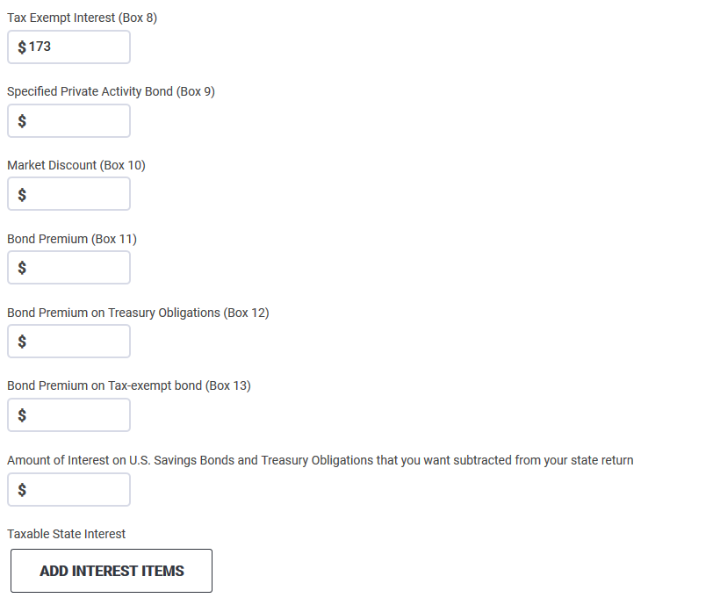
Entering 1099-Int for Obligation of Another State Tax exempt for Federal, Taxable for NJ
Tax-exempt for Federal
Click to add to New Jersey State Return

Slide 8
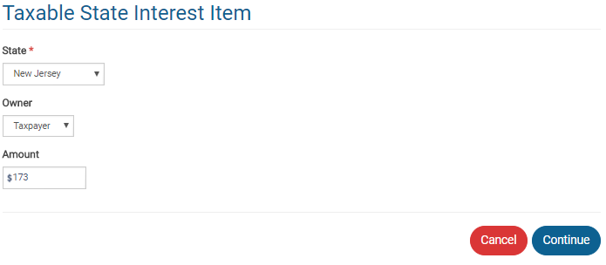
Entering 1099-INT for Obligation of Another State Tax exempt for Federal, Taxable for NJ
Federal tax exempt amount that is taxable for NJ

Slide 9
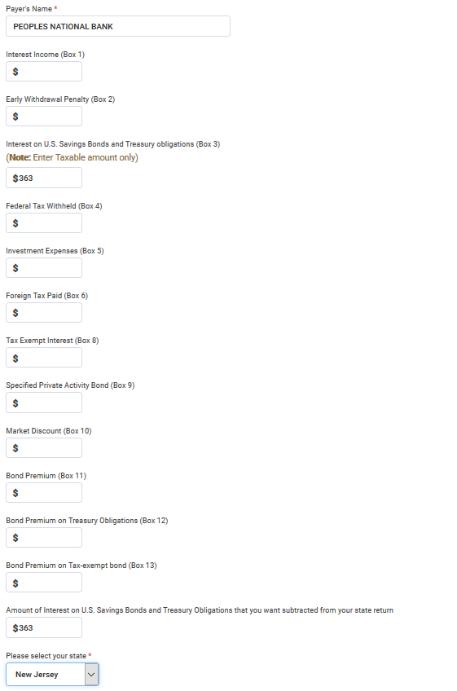
Entering 1099-INT for US Government Obligation Taxable for Federal, Tax Exempt for NJ
Taxable for Federal
Tax Exempt for NJ, subtract from state return

Slide 10
1099-INT on Brokerage Statement
Summary of potentially many individual transactions
Only summary values need to be entered on TaxSlayer Interest screen
Use name of Brokerage as payer
Detail transactions backing up summary data are usually listed on later pages in statement
If there is a tax-exempt interest amount (Box 8), then that amount is tax exempt federally, but you may need to examine detail to determine how much is tax exempt for New Jersey
Tax-exempt mutual funds should have a breakdown of tax-exempt percentages by state

Slide 11
Exempt Interest Dividends from Mutual Funds
Tax exempt on Federal return
Taxability varies for NJ, depending on bonds held by fund (look at statement detail pages)
Interest attributable to Federal obligations (including P.R., territories, etc.) always tax exempt
Interest attributable to other states except NJ always taxable
Interest attributable to NJ bonds only tax exempt if fund is “NJ Qualified Investment Fund” (usually has NJ in name of fund)
Interest on NJ bonds held individually by taxpayer (not in a mutual fund) always tax exempt

Slide 12
TS – Entering Exempt Interest Dividends
Enter full amount of Federal Exempt Interest Dividends from Box 10 on Dividend Income screen
Brokerage statement usually provides percentages of bonds in different categories (i.e. – Federal, each state). Apply those percentages to Federal Exempt Interest Dividends amount as appropriate
Click “Add Dividend Items” to add a Taxable State Interest Item screen
If Federal or multi-state fund, add all non-Federal amounts (including NJ amounts) as amount that is taxable for NJ
If fund is NJ specific, add only amount from states other than NJ as amount that is taxable for NJ

